Slide 1
Classes of networks

Slide 2
Acyclic directed network
Acyclic network: a network has no cycles.
Citation network is acyclic (a paper can only cite another paper if it has already been written).
Vertices are laid out in such a way that all edges point downward.

Slide 3
Vertices are laid out in such a way that all edges point downward
For an acyclic network, there must be a vertex without outgoing edges.
Draw this vertex at the bottom.
Remove that vertex from the original acyclic network and all the edges attached to it.
Repeat the process.
5
4
Choose one of them
2
3
1

Slide 4
An algorithm to check whether a network is acyclic
1. Find a vertex with no outgoing edge.
2. If no such vertex exists, the network is cyclic. Otherwise, if such a vertex does exist, remove it and all its incoming edges from the network.
3. If all the vertices have been removed, the network is acyclic. Otherwise, go back to Step 1.

Slide 5
Vertices are laid out in such a way that all edges point downward
There can be an edge from vertex j to vertex i if j>i.
The adjacency matrix is strictly upper triangular (upper triangular with the diagonal element being all 0).
Through relabling, any acyclic network has a strictly upper triangular adjacency matrix.
All the eigenvalues of the adjacency matrix of an acyclic network are 0. (this is necessary and sufficient)
5
1
2
3
4
5
4
1
2
2
3
A=
3
4
1
5

Slide 6
Hypergraphs
Hyperedge: an generalized edge that joins more than two vertices.
A hyperedge is a group of vertices.
Hypergraph: a graph with hyperedges.
Affiliation networks: films and actors.
A
1
4
B
3
D
C
2
5

Slide 7
Bipartite networks
Transform a hypergraph into a bipartitie network (two-mode network)
There are two kinds of vertices, one representing the original vertices and the other representing the groups to which they belong.
A
A
B
C
D
1
4
B
3
D
C
2
5
1
2
3
4
5

Slide 8
Bipartite networks
Another example: two kinds of vertices correspond to men and women and the edges between them marriage
Incidence matrix B (g×n matrix)
B_{ij}=1 if vertex j belongs to group i

Slide 9
One-mode projections
A
B
C
D
Two actors are connected if they appeared in the same film.
Two films are connected if they
have the same actor.
Films
Actors
1
2
3
4
5
6
7
7
2
5
1
6
3
4
A
B
C
D

Slide 10
Trees
A tree is a connected, undirected network that contains no closed loops.
Root and leaves
There is exactly one path between any pair of vertices.
A tree of n vertices contains exactly n-1 edges. (Prove by induction)
Root
Leaves

Slide 11
Planar networks
A planar network is a network that can be drawn on a plane without having any edges cross.
River networks, road networks
Four color theorem: one needs at most four colors to color a planar graph so that no two connected vertices have the same color. (Prove by computer for many cases)
Chromatic number of a graph: the number of colors needed to color the graph.

Slide 12
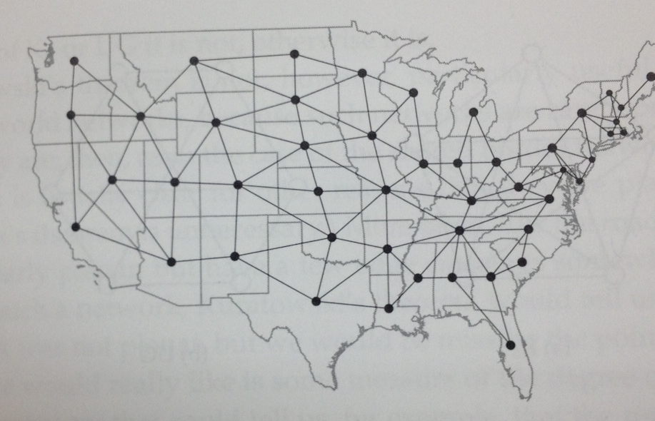
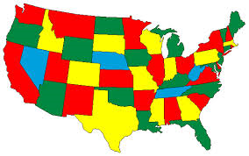
Four color map

Slide 13
Degree
The degree of a vertex is the number of edges connected to it.
k_{i}: the degree of vertex i
m: number of edges
2m ends of edges (every edge has two ends)

Slide 14
Mean degree
c: the mean degree of a vertex in an undirected graph
The maximum possible number of edges is (n-1)n/2.

Slide 15
Density
Density (connectance): the fraction of the maximum number of edges that actually present
For large network (n is very large)

Slide 16
Density
A (large) network is said to be dense if the density ρ tends to a constant as
On the other hand, it is said to be sparse if ρ tends to 0 as

Slide 17
Regular graphs
A regular graph is a graph in which all the vertices have the same degree.
k-regular graph: every vertex has degree k
2-regular: ring
4-regular: square lattice

Slide 18
Degree in directed networks
In-degree: the number of incoming edges
Out-degree: the number of outgoing edges

Slide 19
Degree in directed networks
m: the number of edges
The mean in-degree and the mean out-degree are equal

Slide 20
Path
Path: a sequence of connected vertices
Self-avoiding path: a path that does not intersect itself
Length of a path: the number of edges in the path
If there is a path of length 2 from j to i via k, then A_{ik}A_{kj}=1.

Slide 21
Paths and adjacency matrix
: the number of paths of length 2 from j to i
: the number of paths of length 3 from j to i

Slide 22
Paths and adjacency matrix
: the number of paths of length r from j to i
Loop: the start vertex and the end vertex of a path are the same
L_{r}: the total number of loops of length r

Slide 23
The number of loops in an undirected graph
The adjacency matrix A in an undirected graph is symmetric.
It has n real eigenvaues.
It is diagonizable and there exists an orthogonal matrix U such that
Where K is a diagonal matrix of eigenvalues.

Slide 24
The number of loops in an undirected graph
Where is the i^{th} eigenvalue of the adjacency matrix A

Slide 25
The number of loops in an directed graph
The adjacency matrix is not symmetric.
It may not be diagonizable
Schur theorem: there is an upper triangular matrix T and an orthogonal matrix Q such that

Slide 26
The number of loops in an directed graph
Suppose k is an eigenvalue of A with the eigenvector x, i.e.,
Then
k is also an eigenvalue of T with the eigenvector
This also shows that the eigenvalues of the adjacency matrix A of an acyclic network are all 0.

Slide 27
Geodesic paths
A geodesic path (shortest path) is a path between two vertices that no shorter path exists
Geodesic distance (shortest distance): the length of a geodesic path
The smallest value r such that
Geodesic paths are self-avoiding (Why?)
Geodesic paths are not necessarily unique

Slide 28
Diameter
The diameter d of a graph is the length of the longest geodesic paths between any pairs of vertices in a network.
Suppose that is the geodesic distance between vertices i and j

Slide 29
Eulerian path and Hamiltonian path
Eulerian path: a path that traverses each edge in a network exactly once.
Hamiltonian path: a path that visits each vertex in a network exactly once.
(self-avoiding)
A Eulerian path is not necessarily self-avoiding.

Slide 30
Königsberg bridge probelm
4 land masses, 7 bridges
Does there exist a walking route that crosses every bridge exactly once?
Eulerian path
A network can have an Eulerian path only if there are exactly two or zero vertices of odd degree

Slide 31
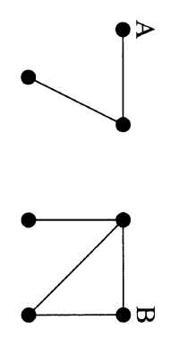
Components
A network is connected if there is a path from every vertex to any other vertex.
Disconnected networks can be separated into several components.
Components:
  There is a path from every vertex in the subnetwork to any other vertex in the same subnetwork.
  No other vextex can be added while preserving this property.

Slide 32
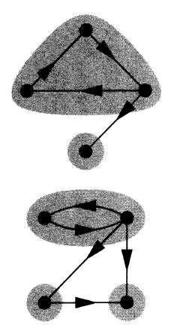
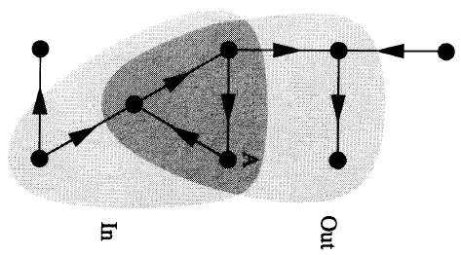
Components in directed networks
Weakly connected: ignored the directed nature of edges
Strongly connected: there is a directed path from every vertex to any other vertex.
Out-component of a vertex A:
the set of vertices that can be reached
by directed paths from vertex A
and including A itself.
In-component of a vertex A:
the set of vertices from which there is
a directed path to A, including A itself.

